Slide 1
Quality Improvement Webinar Series: Member Satisfaction
May 5, 2020

Slide 2
Agenda
Overview of CAHPS
Overview of Survey Domains & Questions
Review HPP’s performance & impact
Discuss your value proposition
Discuss strategies to improve Member Satisfaction
Q&A

Slide 3
What is CAHPS?
CAHPS = Consumer Assessment of Healthcare Providers and Systems
Background:
Considered the national standard for measuring and reporting on consumers’ experiences with health plans, providers and the services provided.
CAHPS surveys measure the patients’ perception of the quality received, such as the ease of access to providers and health care services and the patient/provider relationship, including the communication skills of physicians and practitioners.
Programs Impacted:
Medicare Stars
NCQA Accreditation
NCQA Ratings
Marketing/ Enrollment
Provider Evaluation Programs
DHS/CMS

Slide 4
Type of Member Satisfaction (CAHPS) Surveys
CMS continues to leverage member satisfaction surveys in various settings to help existing and potential beneficiaries select quality care by making the selection process more transparent.
Ambulatory Care Surveys
Clinician & Group (CG-CAHPS)
Health Plan
Surgical Care
ECHO (Behavioral health)
Dental Plan
American Indian
Home Health Care
Home and Community-Based Services (HCBS)
Outpatient and Ambulatory Surgery
Facility Surveys
Hospital
In-Center Hemodialysis
Nursing Home
Hospice

Slide 5
Member Satisfaction Survey Topics that YOU can Impact
Annually, Medicare, Medicaid and CHIP members are asked to answer ~70 survey questions on the following topics/composites
Annual Flu Vaccine: asks our members if they had a Flu Shot since July 1, 2019
Getting Needed Care: questions about how often it was easy for them to get appointments with specialists and get the care, tests, or treatment that they need
Getting Care Quickly: questions about how often they got care as soon as needed when sick or injured and got non-urgent appointments quickly
Customer Service: questions about how often staff were helpful and treated them with courtesy and respect
Members’ Ratings of the healthcare quality: The survey asked members to rate (0-10) the satisfaction with their overall healthcare experience
Getting Needed Prescription Drugs: The survey asked members how often was it easy for them to get the medicines prescribed?

Slide 6
Examples of Survey Questions
Annually, Medicare, Medicaid and CHIP members are asked to answer ~70 survey questions on the following topics/composites. Here are some examples of questions:
Annual Flu Vaccine
• Have you had a flu shot?
How Well Doctors Communicate
On a scale from 0 to 10, how would you rate your …
• … How often did your personal doctor explain things in a way that was easy to understand?
• … How often did your personal doctor listen carefully to you?
• … How often did your personal doctor show respect for what you had to say?
• … How often were the forms from your health plan easy to fill out?
Getting Needed Care
How would you rate your ease and timeliness of …
• … getting appointments with specialists?
• … getting the care, tests or treatment you needed?
Care Coordination
Has your personal doctor or doctor’s office …
• … managed your care among different providers and services to your satisfaction?
• … followed up promptly on test results?
• … talked to you about all the medications you take?
Getting Appointments and Care Quickly
How often have you…
• … gotten urgent care as soon as needed?
• … gotten appointments at your doctor’s office?
• … been seen within 15 minutes of your appointment time?
Overall Ratings
On a scale from 0 to 10, how would you rate your …
• … overall health care?
• … personal doctor?
• … specialist seen most often?
Medicare Survey | Medicaid Adult Survey | Medicaid Child Survey

Slide 7
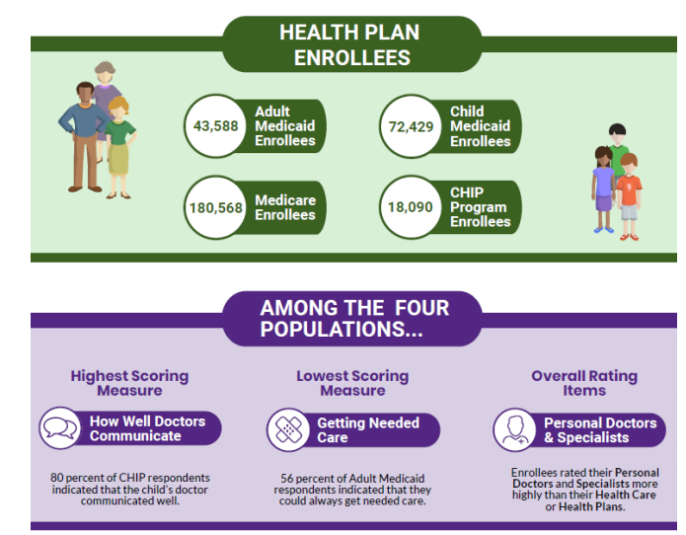
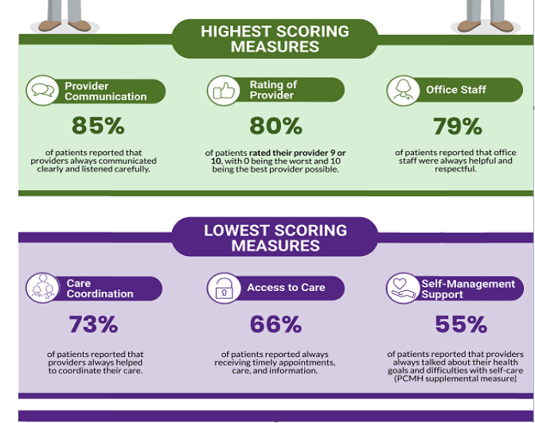
Industry Results (based on most recent CAHPS surveys)
The industry as a whole has many improvement opportunities and the key areas requiring improvement have remained the same over the last few years.
Health Plan CAHPS Survey
CG-CAHPS Survey
To view the full 2019 Chart book: https://cahpsdatabase.ahrq.gov/files/2019CAHPSHealthPlanChartbook.pdf
For more information on the CAHPS Health Plan Survey Database: https://cahpsdatabase.ahrq.gov/HPSurveyGuidance.aspx
To view the full 2018 Chart book: https://cahpsdatabase.ahrq.gov/files/2018CAHPSClinicianGroupChartbook.pdf
For more information on the CAHPS Clinician & Group Survey Database: https://cahpsdatabase.ahrq.gov/CGSurveyGuidance.aspx
Source: AHRQ Pub. No. 20-M003-1 October 2019

Slide 8
HPP’s Member Satisfaction Performance
HPP reviews our satisfaction results annually using the official CAHPS results for all lines of business and member satisfaction remains a priority year-round.
Medicaid:
CAHPS Measure – Adult Survey | 2018 Measurement Rate | 2018 Percentile Met | 2019 Measurement Rate | 2019 Percentile Met
1. Rating of All Health Care | 75.13 | 50th | 80.77 | 75th
2. Rating of Health Plan | 81.61 | 75th | 80 | 66.67th
3. Getting Needed Care - Composite Measure | 86.56 | 75th | 84.82 | 50th
4. Getting Care Quickly - Composite Measure | 83.39 | 50th | 82.39 | 50th
CAHPS Measure – Child Survey | 2018 Measurement Rate | 2018 Percentile Met | 2019 Measurement Rate | 2019 Percentile Met
1. Rating of All Health Care | 83.12 | 5th | 83.85 | 10th
2. Rating of Health Plan* | 87.86 | 50th | 89.49 | 75th
3. Getting Needed Care - Composite Measure | 82.09 | 25th | 86.36 | 50th
4. Getting Care Quickly - Composite Measure | 84.46 | 10th | 87.48 | 25th
Medicare:
Parent Organization | Annual Flu Vaccine | Getting Needed Care | Getting Appointments and Care Quickly | Customer Service | Overall Rating of Plan | Care Coordination | Rating of Drug Plan | Getting Needed Prescription Drugs
HPP | 68 | 81 | 73 | 90 | 87 | 83 | 87 | 90
HPP Versus Industry | -5.00 | -2.00 | -5.00 | -1.00 | 1.00 | -3.00 | 2.00 | 0.00
HPP Versus Local | -6.29 | -2.57 | -4.57 | -0.71 | 0.00 | -3.57 | 1.43 | 0.00

Slide 9
Strategies for Improving Patient Experience
HPP has compiled some recommendations for your office to consider in order to improve member satisfaction.
Activities
Actions
Complete an end-to-end review of your existing processes impacting members (e.g., call center to check out process).
Understand what constitutes high quality service from the perspective of your patients.
Review access & availability results and compare against standards.
Review HPP’s survey results and member level feedback around practice specific issues.
Review practice standards & process alignment across providers and sites.
Review policies and procedures related to the patient experience and ensure all staff are aware and understand them.
Define and share service standards that clearly tell your staff what is expected of them in their interactions with patients.
Create open access scheduling for routine and urgent appointments.
Conduct training to advance the communication and customer service skills of your clinicians and administrative staff.
Leverage/Create tools to help patients communicate their needs (e.g., portal access, PFACs meetings and in-office surveys).
Assess and improve staff’s cultural competence.
Design rapid referral & service recovery programs.
Leverage reminder systems for preventive services and immunizations.
Revise and/or standardize your processes as needed to account for any negative member experiences.
Reference: AHRQ Standards for Customer Service (from Improvement Guide)
https://cahps.ahrq.gov/quality-improvement/improvement-guide/6-strategies-for-improving/customer-service/strategy6q-custservice-standards.html

Slide 10
HPP Activities & Resources
HPP is actively vested and engaged in partnering with our provider community to improve our member satisfaction results.
Projects
Project | Description | Go-Live
Member Satisfaction Surveys | Members receive a phone survey after PCP visits | 2018
Member Satisfaction Measure | Provider Satisfaction score/measure is included in QCP | 2019
Provider Customer Experience Training | 6-month CX engagement to address member satisfaction | 2019
Webinars Materials
Communication (letters/fax)
Description | Resource
Creating Exceptional Patient Experience
Handling Complaints
Improving Waiting Time
Leading Organizational Change
Strengthening Patient Engagement and Treatment Participation
Description
What are CAHPS and HOS Surveys?
Impacting CAHPS and HOS Quality Measures: A Checklist for Providers
Top 5 Tips for Improving Front Office Customer Service
Top 5 Tips for Boosting Member Satisfaction Scores
How Focusing on the Health Outcomes Survey (HOS) Can Improve Your Practice
Available via your NAM
What other resources/tools would you like to see created?

Slide 11
QUESTIONS?
Thank you for your participation!

